Slide 1
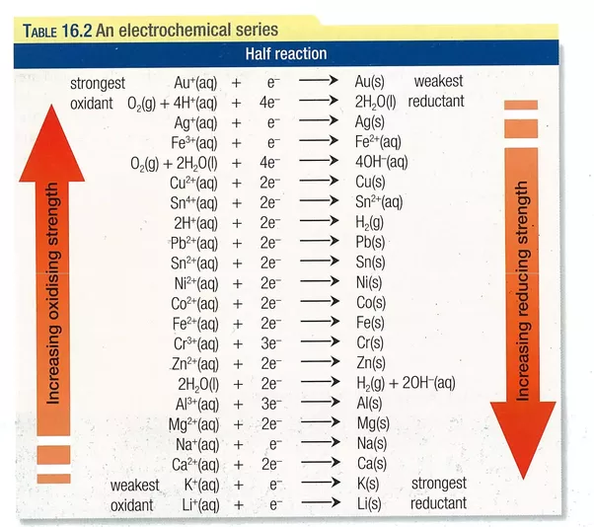
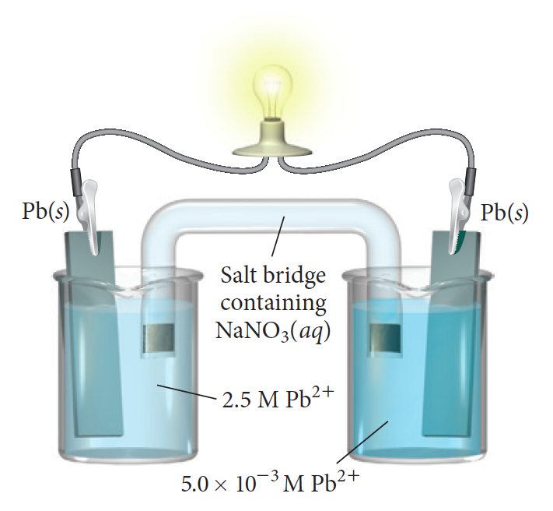
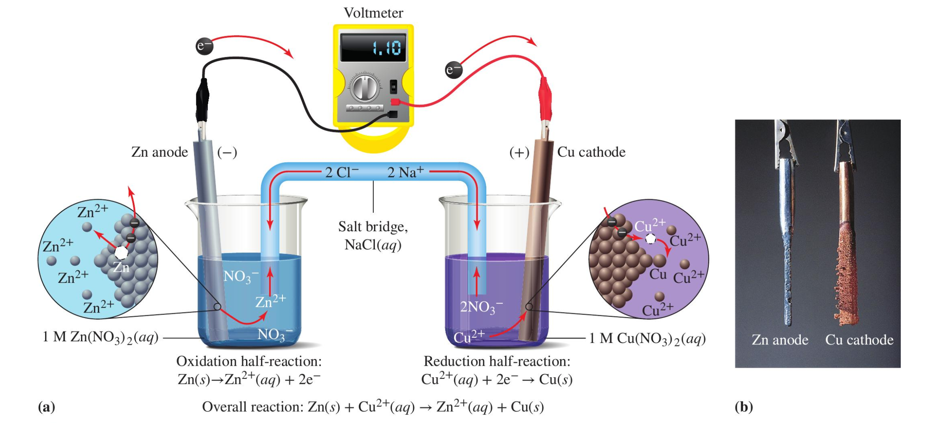
The iron-lead Galvanic cell
Black
Red
Fe(s)
Fe²⁺
Pb²⁺

Slide 2
The iron-lead Galvanic cell … Pb²⁺/Pb reduction is higher, so it’s the cathode
Black
Red
Fe(s)
Fe²⁺
Pb²⁺
anode
cathode

Slide 3
That tells us the electrons move like this
Black
Red
Fe(s)
Fe²⁺
Pb²⁺
anode
cathode

Slide 4
Since the red lead is connected to the cathode => Voltage > 0
Black
Red
Fe(s)
Fe²⁺
Pb²⁺
anode
cathode

Slide 5
Since the red lead is connected to the cathode => Voltage > 0
Black
+0.32
Red
Fe(s)
Fe²⁺
Pb²⁺
anode
cathode

Slide 6
But why that particular number (0.32 V)?
Black
+0.32
Red
Fe(s)
Fe²⁺
Pb²⁺
anode
cathode

Slide 7
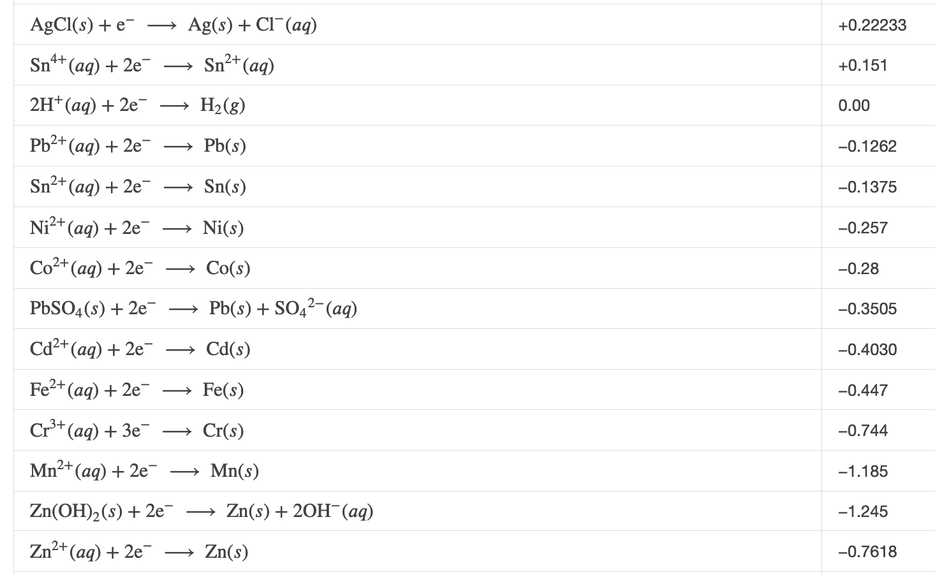
Using a Quantitative Standard Reduction Potential Table
½-cell potential
https://openstax.org/books/chemistry-atoms-first-2e/pages/16-3-electrode-and-cell-potentials#fs-idm42585168

Slide 8
Using a Quantitative Standard Reduction Potential Table
½-cell potential
-0.1262-(-0.447) = +0.32 V

Slide 9
Your turn: a Lead – Zinc cell
Black
Red
Identify the anode & cathode
Show the direction electrons are going through the wires
Predict whether the voltage will be positive or negative
Predict the value of the voltage measured
Zn(s)
Zn²⁺
Pb²⁺
-0.1262-(-0.7618) = +0.64 V

Slide 10
Your turn: a Lead – Zinc cell
½-cell potential

Slide 11
Your turn: a Lead – Zinc cell
½-cell potential
-0.1262-(-0.7618) = +0.64 V

Slide 12
Your turn: a Lead – Zinc cell
½-cell potential
Black
+0.64
Red
Zn(s)
Zn²⁺
Pb²⁺
-0.1262-(-0.7618) = +0.64 V
anode
cathode

Slide 13
Your turn: a Iron – Zinc cell
Black
Red
Identify the anode & cathode
Show the direction electrons are going through the wires
Predict whether the voltage will be positive or negative
Predict the value of the voltage measured
Zn(s)
Fe(s)
Fe²⁺
Zn²⁺

Slide 14
Your turn: a Iron – Zinc cell
Black
+0.31
Red
Zn(s)
Fe(s)
Fe²⁺
Zn²⁺
anode
cathode
-0.447-(-0.7618) = +0.31 V

Slide 15
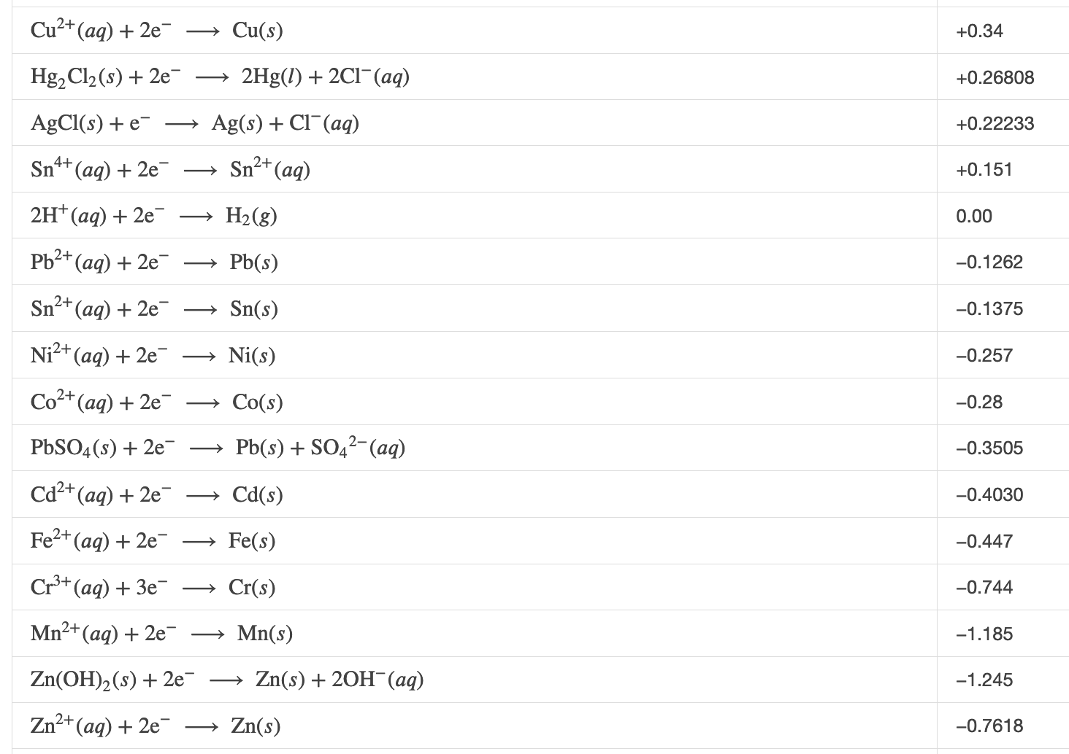



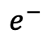


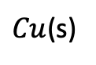
In lab, you’ll make a Daniell Cell
Which is the cathode?
Where are ions moving?
What will the voltage be?
$$Salt$$
$$bridge$$
$$Zn^{2+}$$
$${Cu}^{2+}$$
$$Zn(s)$$
$Cu$(s)
$$e^{−}$$
?

Slide 16
In lab, you’ll make a Daniell Cell
Which is the cathode?
Where are ions moving?
What will the voltage be?
$$Salt$$
$$bridge$$
$$Zn^{2+}$$
$${Cu}^{2+}$$
$$Zn(s)$$
$Cu$(s)
$$e^{−}$$
?

Slide 17



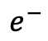
In lab, you’ll make a Daniell Cell
Which is the cathode?
Where are ions moving?
What will the voltage be?
$${Na}^{+}$$
$$Zn^{2+}$$
$${Cu}^{2+}$$
anode
cathode
$$Zn(s)$$
$Cu$(s)
$$e^{−}$$
?

Slide 18

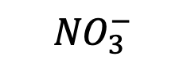
In lab, you’ll make a Daniell Cell
Which is the cathode?
Where are ions moving?
What will the voltage be?
$${Cl}^{−}$$
$${Na}^{+}$$
$${NO}_{3}^{−}$$
$$Zn^{2+}$$
$${Cu}^{2+}$$
anode
cathode
$$Zn(s)$$
$Cu$(s)
$$e^{−}$$
?

Slide 19
In lab, you’ll make a Daniell Cell
Which is the cathode?
Where are ions moving?
What will the voltage be?
$$Salt$$
$$bridge$$
$$Zn^{2+}$$
$${Cu}^{2+}$$
anode
cathode
$$Zn(s)$$
$Cu$(s)
$$e^{−}$$
?

Slide 20
In lab, you’ll make a Daniell Cell
Which is the cathode?
Where are ions moving?
What will the voltage be?
$$Salt$$
$$bridge$$
$$Zn^{2+}$$
$${Cu}^{2+}$$
+1.10
anode
cathode
$$Zn(s)$$
$Cu$(s)
$$e^{−}$$
1.10

Slide 21


You’ll also get an unknown ...
What is the voltage?
Which is the cathode?
What is the unknown metal?
$$Salt$$
$$bridge$$
$$Zn^{2+}$$
$$?$$
$$Zn(s)$$
$$?$$
$$e^{−}$$

Slide 22
You’ll also get an unknown ...
What is the voltage?
Which is the cathode?
What is the unknown metal?
$$Salt$$
$$bridge$$
$$Zn^{2+}$$
$$?$$
anode
cathode
$$Zn(s)$$
$$?$$
$$e^{−}$$
0.48

Slide 23
You’ll also get an unknown ...
What is the voltage?
Which is the cathode?
What is the unknown metal?
$$Salt$$
$$bridge$$
$$Zn^{2+}$$
$$?$$
anode
cathode
$$Zn(s)$$
$$?$$
?
$$e^{−}$$
0.48

Slide 24
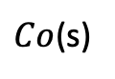
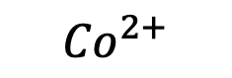
You’ll also get an unknown ...
What is the voltage?
Which is the cathode?
What is the unknown metal?
$$Salt$$
$$bridge$$
$$Zn^{2+}$$
$${Co}^{2+}$$
anode
cathode
$$Zn(s)$$
$Co$(s)
+0.48
$$e^{−}$$
0.48

Slide 25
Next: What if the two sides have the same cation?
Black
Red
Pb²⁺
Pb²⁺
To answer this, we have to talk about concentrations

Slide 26
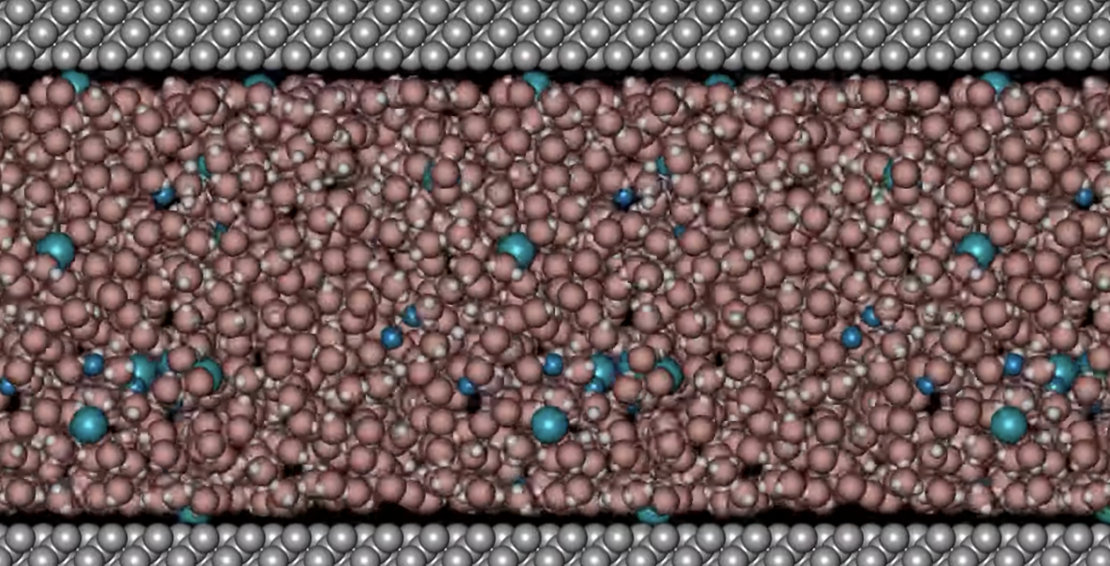
Solutions, solvents, and solutes
https://youtu.be/Khg9ozS8A6U
In this solution (mixture), water is the solvent, the other things (cations and anions) are solutes.
Generally, there’s a lot more of the solvent.

Slide 27
Molarity as a measure of concentration
https://youtu.be/Khg9ozS8A6U
Chemists measure the concentration of solute using a unit called molarity: it’s the # of moles of the solute in each Liter of solution.
The symbol for molarity is “M”
In the bracket notation for molarity, “[X]” means “concentration of solute X”

Slide 28
Example: concentrations of cations in this Daniell cell are all 1 M
[Zn²⁺] = 1 M
means there’s 1 mole of Zn²⁺ in every liter of this solution
[Cu²⁺] = 1 M means there’s 1 mole of Cu²⁺ in every liter of this solution
In all the previous examples today, the concentrations were 1 M too.

Slide 29
Back to our cell that has Pb²⁺ on both sides …
Black
0.0
Red
[Pb²⁺] = 1 M
[Pb²⁺] = 1 M
Pb²⁺
Pb²⁺
If the concentrations are the same, and it’s the same cation, then we can expect that there would be no movement of electrons; there’s no cathode or anode, and the voltage is zero.

Slide 30
Pb²⁺ cell with different concentrations …
This kind of cell is called a concentration cell (and you’ll be making one in lab!)
Black
0.004
Red
[Pb²⁺] = 1 M
[Pb²⁺] = 2 M
Pb²⁺
Pb²⁺
Pb²⁺
Which is the cathode now?
If the voltage > 0, then the electrode connected to the red lead is the cathode
If the voltage < 0, then the electrode connected to the black lead is the cathode

Slide 31
Pb²⁺ cell with different concentrations …
Black
0.004
Red
[Pb²⁺] = 1 M
[Pb²⁺] = 2 M
Pb²⁺
Pb²⁺
Pb²⁺
anode
cathode
If the voltage > 0, then the electrode connected to the red lead is the cathode
If the voltage < 0, then the electrode connected to the black lead is the cathode

Slide 32
Pb²⁺ cell with different concentrations …
Why?
Black
0.004
Red
[Pb²⁺] = 1 M
[Pb²⁺] = 2 M
Pb²⁺
Pb²⁺
Pb²⁺
anode
cathode
If the voltage > 0, then the electrode connected to the red lead is the cathode
If the voltage < 0, then the electrode connected to the black lead is the cathode

Slide 33
Pb²⁺ cell with different concentrations …
Why?
More cations on the right => more competition for electrons
Black
0.004
Red
[Pb²⁺] = 1 M
[Pb²⁺] = 2 M
Pb²⁺
Pb²⁺
Pb²⁺
anode
cathode
If the voltage > 0, then the electrode connected to the red lead is the cathode
If the voltage < 0, then the electrode connected to the black lead is the cathode

Slide 34
Using voltage to tell us about an unknown concentration
Measure the voltage
Identify the cathode
The cathode has higher cation concentration
Black
0.002
Red
[Pb²⁺] = 1 M
[Pb²⁺] = ?
Pb²⁺
Pb²⁺
If the voltage > 0, then the electrode connected to the red lead is the cathode
If the voltage < 0, then the electrode connected to the black lead is the cathode

Slide 35
Using voltage to tell us about an unknown concentration
Measure the voltage
Identify the cathode
The cathode has higher cation concentration
Black
0.002
Red
[Pb²⁺] = 1 M
[Pb²⁺] = ?
Pb²⁺
Pb²⁺
cathode
If the voltage > 0, then the electrode connected to the red lead is the cathode
If the voltage < 0, then the electrode connected to the black lead is the cathode

Slide 36
Using voltage to tell us about an unknown concentration
Measure the voltage
Identify the cathode
The cathode has higher cation concentration
Black
0.002
Red
[Pb²⁺] = 1 M
[Pb²⁺] > 1 M
Pb²⁺
Pb²⁺
cathode
If the voltage > 0, then the electrode connected to the red lead is the cathode
If the voltage < 0, then the electrode connected to the black lead is the cathode

Slide 37
Using voltage to tell us about an unknown concentration
Measure the voltage
Identify the cathode
The cathode has higher cation concentration
Black
-0.049
Red
[Pb²⁺] = 0.1 M
[Pb²⁺] = ?
Pb²⁺
Pb²⁺
If the voltage > 0, then the electrode connected to the red lead is the cathode
If the voltage < 0, then the electrode connected to the black lead is the cathode

Slide 38
Using voltage to tell us about an unknown concentration
Measure the voltage
Identify the cathode
The cathode has higher cation concentration
Black
-0.049
Red
[Pb²⁺] = 0.1 M
[Pb²⁺] = ?
Pb²⁺
Pb²⁺
cathode
If the voltage > 0, then the electrode connected to the red lead is the cathode
If the voltage < 0, then the electrode connected to the black lead is the cathode

Slide 39
Using voltage to tell us about an unknown concentration
Measure the voltage
Identify the cathode
The cathode has higher cation concentration
Black
-0.049
Red
[Pb²⁺] = 0.1 M
[Pb²⁺] < 0.1 M
Pb²⁺
Pb²⁺
cathode
If the voltage > 0, then the electrode connected to the red lead is the cathode
If the voltage < 0, then the electrode connected to the black lead is the cathode

Slide 40
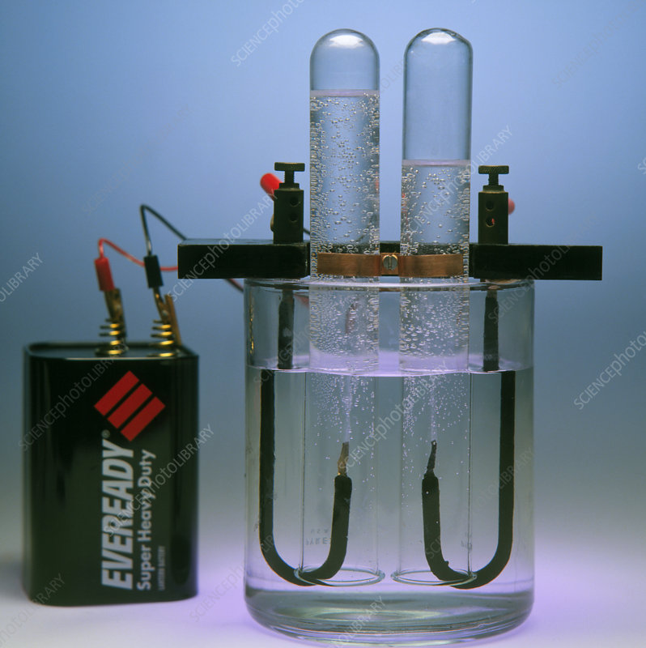
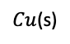
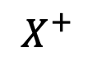

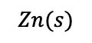
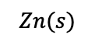
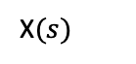
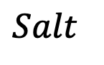
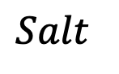
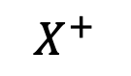
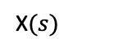

Lab today …
Part 1. Build some Galvanic Cells
Build a Daniell cell, measure its voltage, figure out which is the cathode
Build a cell with unknown “X”, use the voltage to identify the unknown
Build a concentration cell and figure out which side has the higher concentration
Part 2. Look at an electrolysis apparatus
$$Salt$$
$$Zn^{2+}$$
$${Cu}^{2+}$$
$$Zn(s)$$
$Cu$(s)
$$Salt$$
$$e^{−}$$
$$Zn^{2+}$$
$$X^{+}$$
$$Zn(s)$$
X$(s)$
$$e^{−}$$
$$Salt$$
$$X^{+}$$
$$X^{+}$$
X$(s)$
X$(s)$
$$e^{−}$$

